Slide 1





AGILE Scrum and SAFe
TECH TALKS
Ravindra Nikam
Presenter of the topic

Slide 2



AGILE Scrum and SAFe OUTLINE
1. Introduction
2. NLP Applications & business benefit
3. NLP Pipeline
•Tokenization
•Stop word removal, Stemming and Lemmatization
•Part of speech (POS) tagging
•Entity Recognition
•Pattern Recognition
4. Challenges in NLP
•Lexical, Syntactic, Anaphoric, Pragmatic
5. Tools and platforms for NLP
•Platforms from Amazon, Google, Microsoft
6. NLP Demo
7. References
Notes:
Important suggestion,
We know these are challenging times. ISP may struggle service continuity, we may face power outage.
Stay connected to talk session and with available backup option we reconnect session immediately

Slide 3
Agile Software Development
Agile software engineering represents a reasonable alternative to conventional software engineering for certain classes of software and certain types of software projects
Agile development processes can deliver successful systems quickly
Agile development stresses continuous communication and collaboration among developers and customers
Notes:
Important suggestion,
We know these are challenging times. ISP may struggle service continuity, we may face power outage.
Stay connected to talk session and with available backup option we reconnect session immediately

Slide 4
Agile Software Development
Agile software engineering embraces a philosophy that encourages customer satisfaction, incremental software delivery, small project teams (composed of software engineers and stakeholders), informal methods, and minimal software engineering work products
Agile software engineering development guidelines stress on-time delivery of an operational software increment over analysis and design
Notes:
Important suggestion,
We know these are challenging times. ISP may struggle service continuity, we may face power outage.
Stay connected to talk session and with available backup option we reconnect session immediately

Slide 5
Manifesto for Agile Software Development
Proposes that it may be better to value:
Individuals and interactions over processes and tools
Working software over comprehensive documentation
Customer collaboration over contract negotiation
Responding to change over following a plan
Notes:
Important suggestion,
We know these are challenging times. ISP may struggle service continuity, we may face power outage.
Stay connected to talk session and with available backup option we reconnect session immediately

Slide 6
Agility Principles - 1
Highest priority is to satisfy customer through early and continuous delivery of valuable software
Welcome changing requirements even late in development, accommodating change is viewed as increasing the customer’s competitive advantage
Delivering working software frequently with a preference for shorter delivery schedules (e.g. every 2 or 3 weeks)
Business people and developers must work together daily during the project
Notes:
Important suggestion,
We know these are challenging times. ISP may struggle service continuity, we may face power outage.
Stay connected to talk session and with available backup option we reconnect session immediately

Slide 7
Agility Principles - 2
Build projects around motivated individuals, given them the environment and support they need, trust them to get the job done
Face-to-face communication is the most effective method of conveying information within the development team
Working software is the primary measure of progress
Agile processes support sustainable development, developers and customers should be able to continue development indefinitely
Notes:
Important suggestion,
We know these are challenging times. ISP may struggle service continuity, we may face power outage.
Stay connected to talk session and with available backup option we reconnect session immediately

Slide 8
Agility Principles - 3
Continuous attention to technical excellence and good design enhances agility
Simplicity (defined as maximizing the work not done) is essential
The best architectures, requirements, and design emerge from self-organizing teams
At regular intervals teams reflects how to become more effective and adjusts its behavior accordingly
Notes:
Important suggestion,
We know these are challenging times. ISP may struggle service continuity, we may face power outage.
Stay connected to talk session and with available backup option we reconnect session immediately

Slide 9
Agile Process Models
Extreme Programming (XP)
Adaptive Software Development (ASD)
Dynamic Systems Development Method (DSDM)
Scrum
Feature Driven Development (FDD)
Agile Modeling (AM)
Notes:
Important suggestion,
We know these are challenging times. ISP may struggle service continuity, we may face power outage.
Stay connected to talk session and with available backup option we reconnect session immediately

Slide 10
Scrum Terminology
Story points: Estimated time required for the team to complete a user story.
Business Priority: The ranking of the user story based on the Product Owner.
PBI: Product Backlog Item
Product Backlog: an ordered list of the work to be done in order to create, maintain and sustain a product. Managed by the Product Owner
Notes:
Important suggestion,
We know these are challenging times. ISP may struggle service continuity, we may face power outage.
Stay connected to talk session and with available backup option we reconnect session immediately

Slide 11
Scrum Terminology
Scrum Master: the role within a Scrum Team accountable for guiding, coaching, teaching and assisting a Scrum Team and its environments in a proper understanding and use of Scrum.
Scrum Team: a self-organizing team consisting of a Product Owner, Development Team and Scrum Master.
Sprint Backlog: an overview of the development work to realize a Sprint’s goal, typically a forecast of functionality and the work needed to deliver that functionality. Managed by the Development Team.
Sprint Goal: a short expression of the purpose of a Sprint, often a business problem that is addressed. Functionality might be adjusted during the Sprint in order to achieve the Sprint Goal.
Notes:
Important suggestion,
We know these are challenging times. ISP may struggle service continuity, we may face power outage.
Stay connected to talk session and with available backup option we reconnect session immediately

Slide 12
Scrum Meetings
Sprint Planning Meeting
Backlog Refinement Meeting
Daily Scrum Meeting
Spring Review Meeting
Sprint Retrospective Meeting
Notes:
Important suggestion,
We know these are challenging times. ISP may struggle service continuity, we may face power outage.
Stay connected to talk session and with available backup option we reconnect session immediately

Slide 13
Scrum Meetings – Product Backlog Refinement Meeting:
This meeting is used to create and prioritize the Product Backlog Item.
The Product Backlog Item represents User Stories a team needs to complete.
User Stories are thin, vertical slices of product functionalities.
These stories are groomed and prioritized throughout the project because with incremental development there is constant feedback & testing.
The PBI continues to evolve and change as more information is gathered.
The Product Owner is responsible for creating and maintaining the Product Backlog Item.
The goal of Product Backlog Grooming is to review all the PBI and rank them so that they can be consumed by the sprint teams.
A form as shown below is used to record Product Backlog Grooming.
Notes:
Important suggestion,
We know these are challenging times. ISP may struggle service continuity, we may face power outage.
Stay connected to talk session and with available backup option we reconnect session immediately

Slide 14
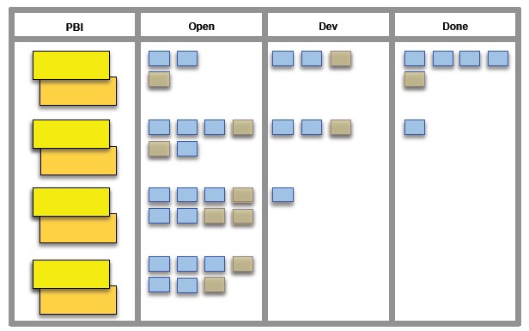
Project Backlog Grooming Form

Slide 15
Scrum Meetings - Sprint Planning Meeting
The goal of the Sprint Planning Meeting is to agree on the sprint goals and negotiate which items from the PBI should be committed to the Sprint Backlog.
In addition the Sprint Team should also come up with an initial list of tasks to complete the committed PBIs.
The Sprint Backlog represents User Stories a team needs to complete in a Sprint.
The Sprint plan is usually two weeks long and is planned out in a 4 hour time boxed Sprint Planning Meeting.

Slide 16
Scrum Meetings - Daily Scrum Meeting or Stand up
This meeting is facilitated by the scrum master
Time boxed usually to 15 minutes
Used to answer the following three questions:
What did you do yesterday
What will you do today
What are your impediments

Slide 17
Scrum Meetings - Daily Scrum Meeting
It is expected that every team member be punctual in attending this meeting.
The product owner however may or may not participate.
During this sprint items for discussions may arise.
Such items should be listed in a side bar and be addressed after the scrum meeting.

Slide 18
Scrum Meetings – Sprint Review Meeting
This meeting is open to all stakeholders.
The agenda for this meeting is:
Product Demonstration
Status Assignment
Velocity Measurement
Stakeholder feedback
The product owner declares if a sprint backlog is completed or not.

Slide 19
Scrum Meetings – Sprint Review Meeting
Product velocity is measured if necessary
Stakeholder feedback is obtained.
For every week of Sprint, 1 hour is time boxed for this meeting.
It is expected that every team member be punctual in attending this meeting.
It is very important that the product owner be present

Slide 20
Burndown Chart
Shows the velocity of the team’s progress by tracking the number of user stories in the sprint backlog each day
Most useful on 2 to 4 week sprints
Best for teams that do about the same amount of work each day otherwise progress displayed my be misleading

Slide 21
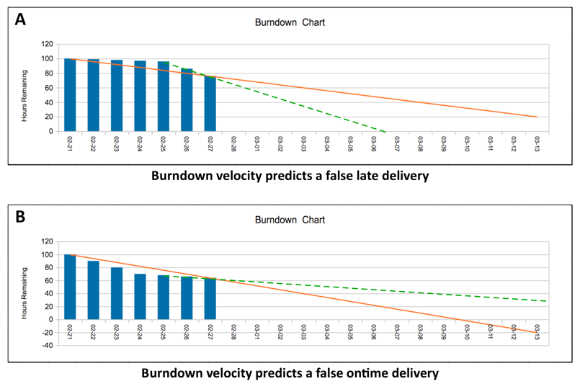
The Burndown Chart

Slide 22
Scrum Meetings – Sprint Retrospective
This meeting is open to all stakeholders.
The purpose of this meeting is to assess the quality of the most recently completed Sprint by ensuring that the SCRUM meetings are being productive.
It is expected that every team member be punctual in attending this meeting.
It is very important that the product owner be present.

Slide 23
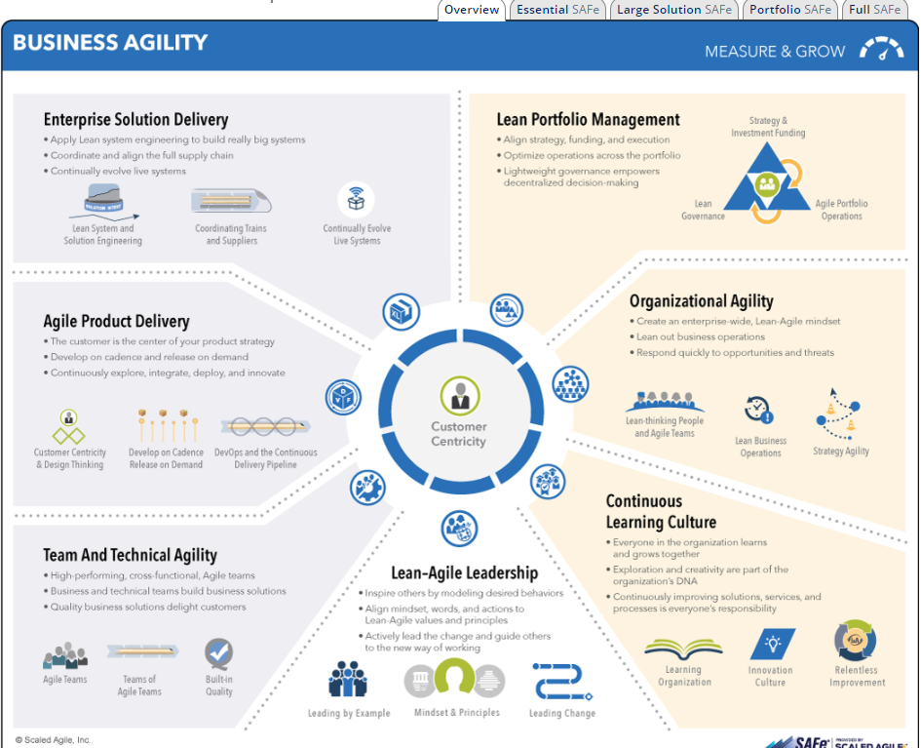
SAFe5.0 for Lean Enterprises

Slide 24
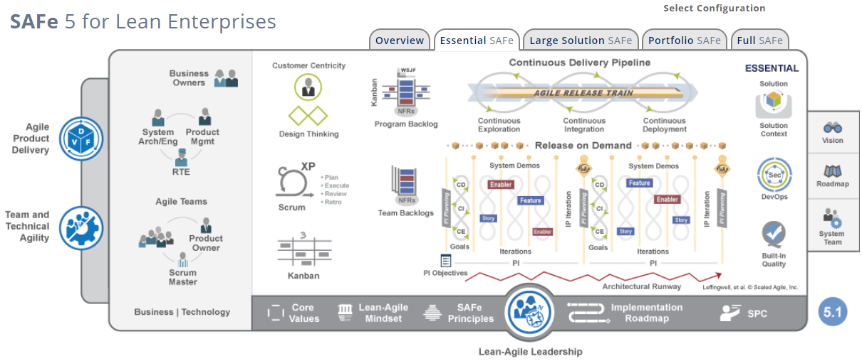
SAFe5.0 for Lean Enterprises

Slide 25
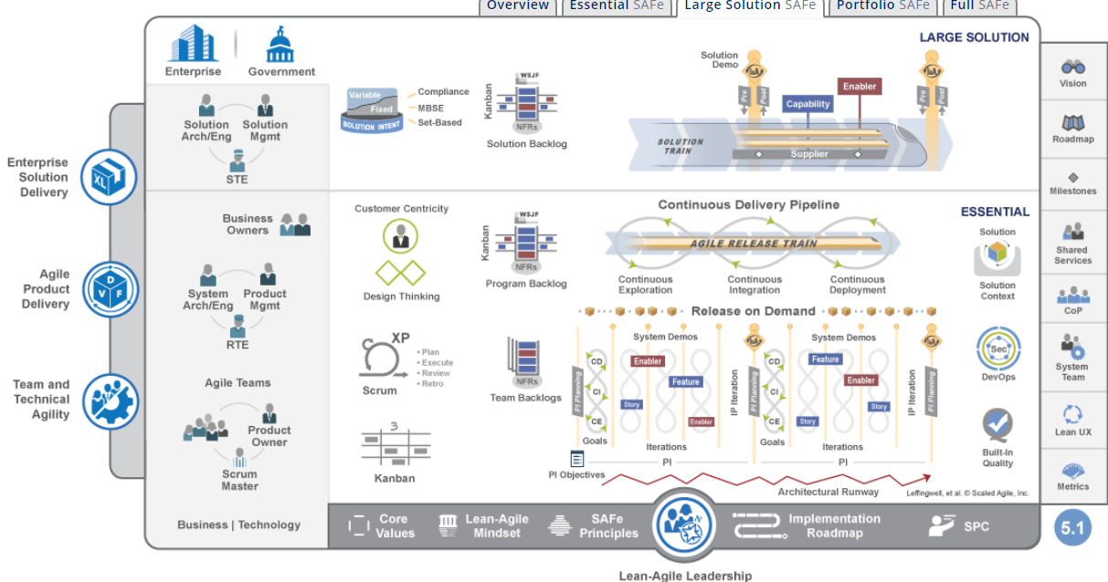
SAFe5.0 for Lean Enterprises

Slide 26
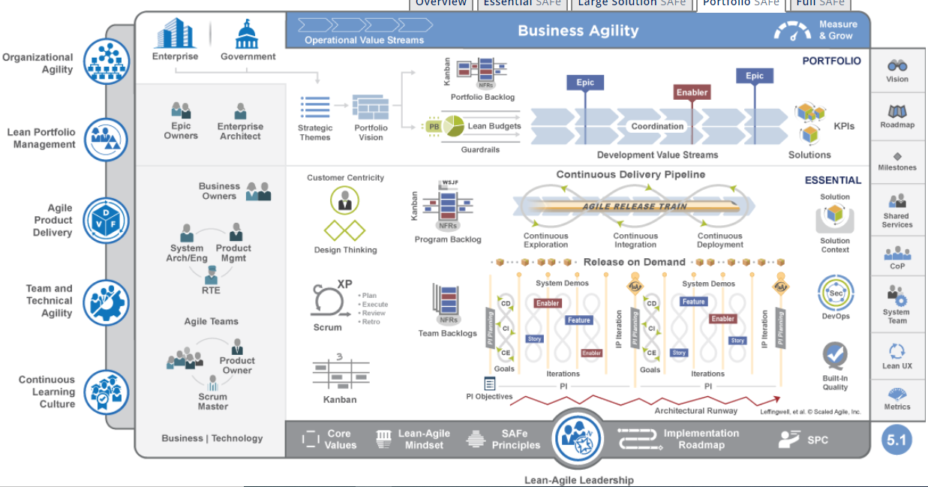
SAFe5.0 for Lean Enterprises

Slide 27
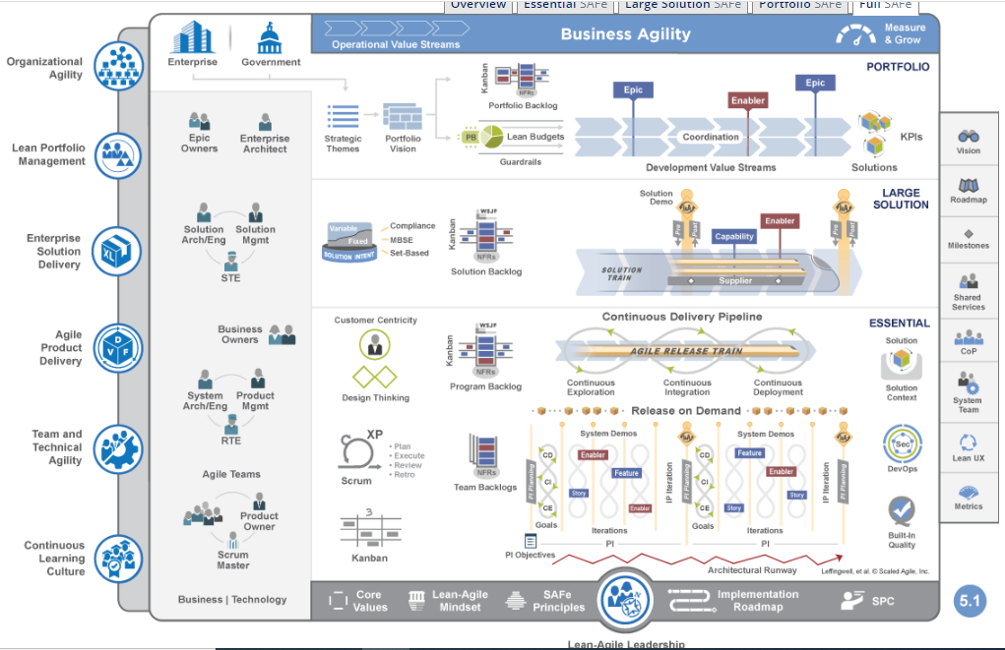
SAFe5.0 for Lean Enterprises

Slide 28
References
•Below are a few recommended references :
•https://www.scaledagileframework.com/
•You could also refer to the online documentation of the following libraries/frameworks:
•

Slide 29

THANK YOU

